Slide 1
Opportunities in the Animal Health Industry
Linda Rhodes, VMD, PhD
(ladycowvet@gmail.com)

Slide 2
My journey
Lady Cow Vet

Slide 3
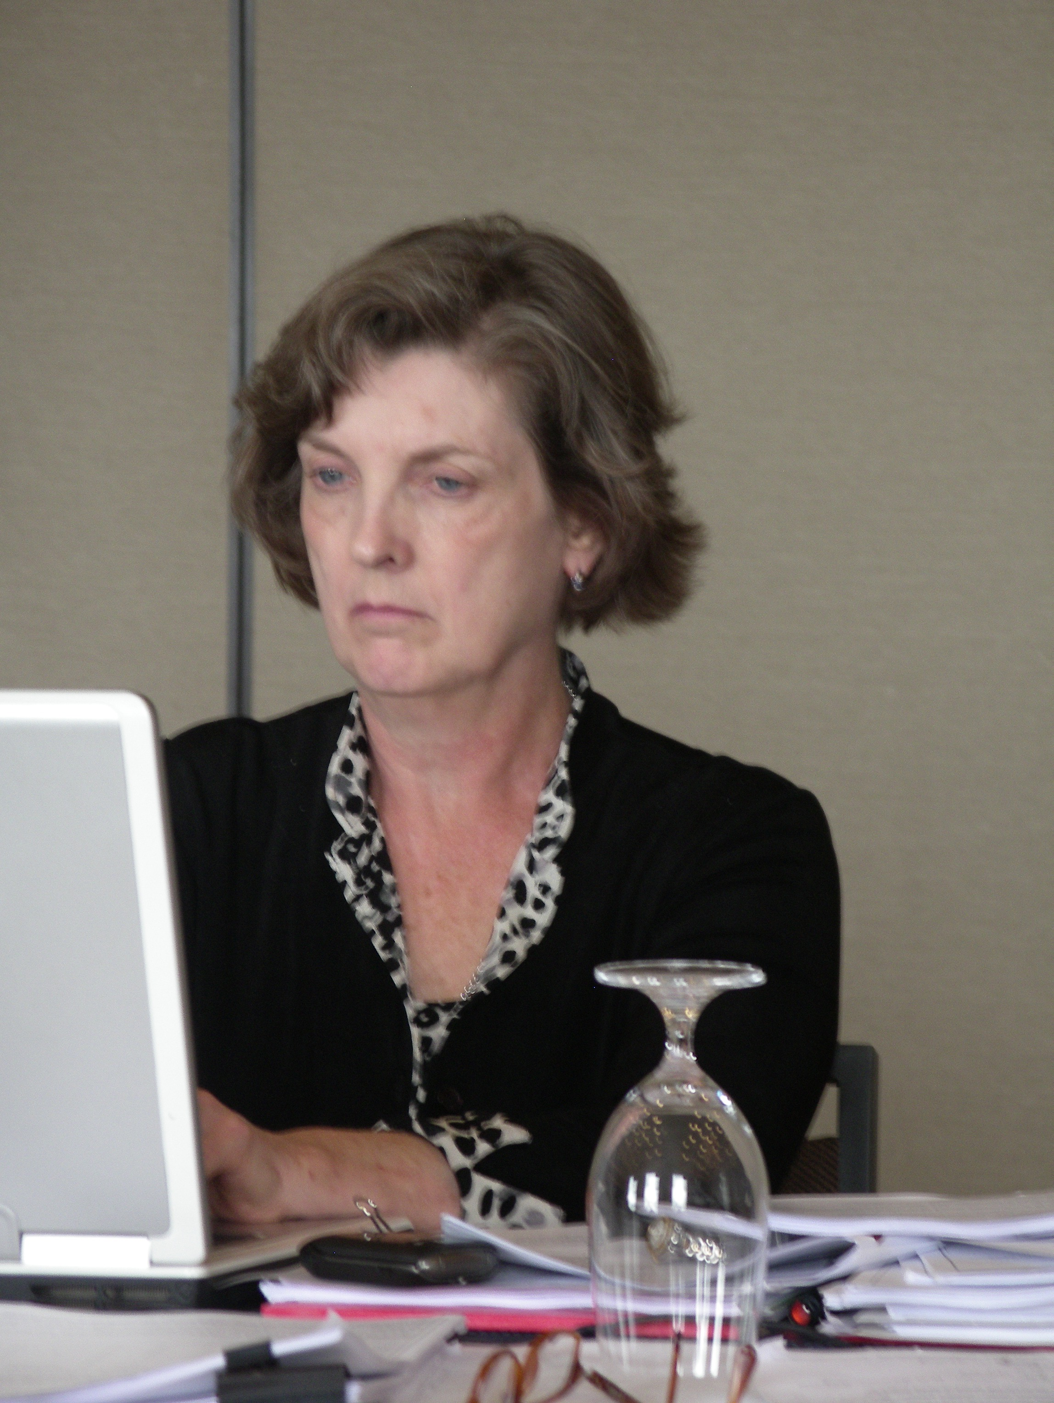

Slide 5
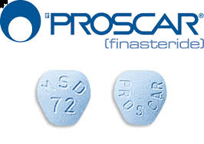

Slide 6
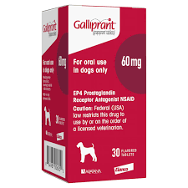
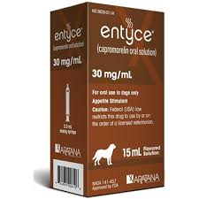
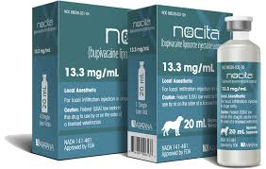
2012-2016

Slide 7
Who is hiring?
Contract research organizations
Argenta (AlcheraBio)
ClinVet
Animal Clinical Investigations
Kingfisher International
Small animal health companies
Big animal health companies

Slide 8
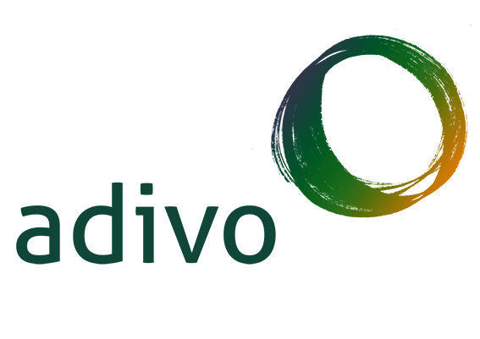

Slide 9
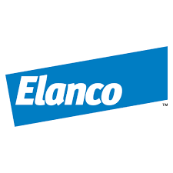

Slide 10
Some useful skills animal scientists have
Experimental design
Biostatistics
Understanding of species differences
Animal care and welfare
Communication: translating science into English
Assay development and validation; laboratory skills
Biomedical writing
Knowledge of housing, nutrition, environment for different species
Familiarity with animal handling of various species
AND MORE!

Slide 11
Take Risks and Explore
Google and LinkedIn are your friends
Network
Internships
Informational Interviews

Slide 12
Where do you fit in?
Early: Understanding the basic biology of a drug target
Middle: Once a ‘lead’ drug is identified, learning as much as possible about it in vitro, and then in animal models
Late: Testing the drug in the actual patient population – clinical trials.

Slide 13
Capromorelin mechanism of action:
Gherlin agonist
Increases appetite, causes an increase in GH and IGF-1 in both dogs and cats
L. Rhodes, B. Zollers, J.A. Wofford, E. Heinen, Capromorelin: a ghrelin receptor agonist and novel therapy for stimulation of appetite in dogs. Vet Med Sci 2018 Feb;4(1):3-16.

Slide 14
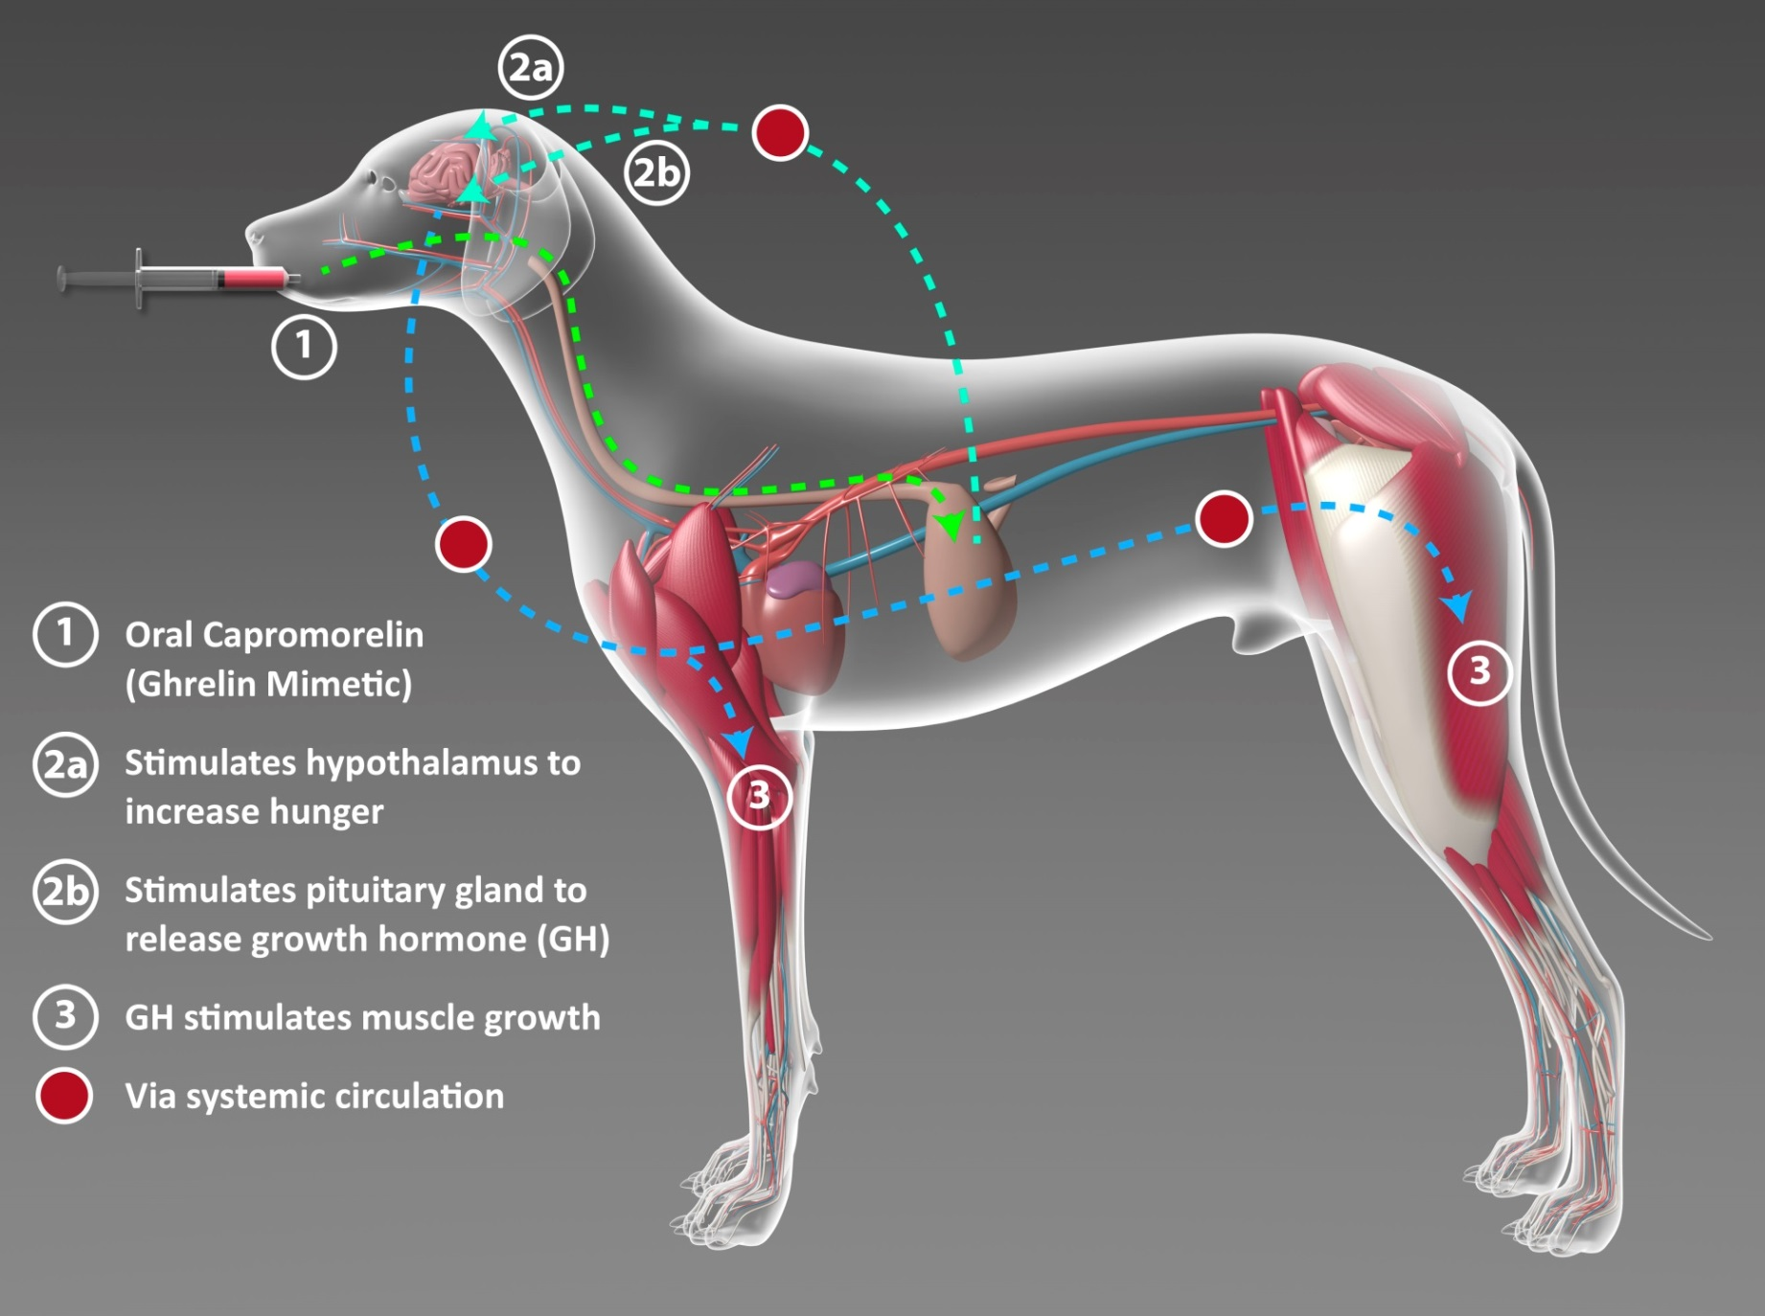
© 2014 Aratana Therapeutics, Inc.

Slide 15
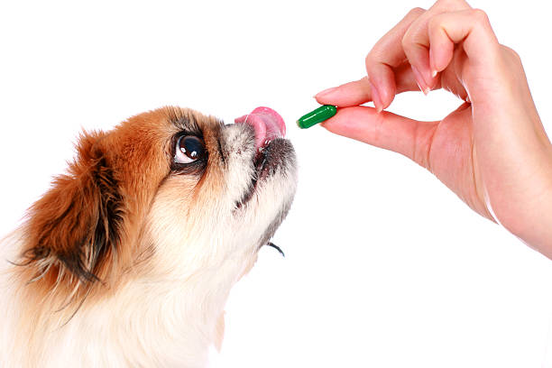
What we need to know about a compound before it becomes a marketed drug
How it works: mechanism of action
Can the drug get to where it needs to go to cause an effect?
Should it be given IV, IM, SC or some other special way (i.e., into a joint)
Is there a way to make it easier to administer?

Slide 16
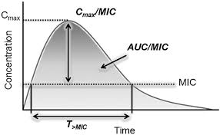
What we need to know about a compound before it becomes a marketed drug
How is it changed in the body?
How is it removed or inactivated from/in the body?
How long does it have to stick around to have an effect?
What is the relationship between the dose and the effect?

Slide 17
What we need to know about a compound before it becomes a marketed drug
Does it have unwanted side effects?
What is the risk/benefit of the drug?
Does it do what we want it to do well enough to be useful?
Will it work in more than one species?

Slide 18
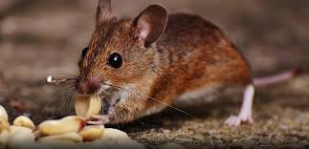
Let’s give it to mice and see if they eat more!
Questions an animal scientist could help answer:
What breed of mice?
Kept under what conditions?
How many mice?
Over what period of time?
What else should we measure?
How should we give the drug?
What dose?
And if your first experiments don’t show an increase in appetite, what would you change in subsequent experiments?

Slide 19
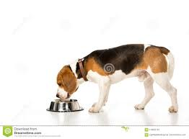
The mice eat more and the drug appears safe given orally- hurrah! Now what?
Questions an animal scientist could help answer:
Does it work in dogs?
Kept under what conditions?
How many dogs?
Over what period of time?
What else should we measure?
How should we give the drug?
What dose?
And if your first experiments don’t show an increase in appetite, what would you change in subsequent experiments?

Slide 20
The dogs eat more and the drug appears safe given orally- hurrah! Now what?
Questions an animal scientist could help answer:
What is the relationship between drug level in the blood, and the increased appetite?
What should the dosing interval be – once a day, twice a day?
Can it be given at a reasonable dose volume?
Do the dogs like it or spit it out? What can we do about that?

Slide 21
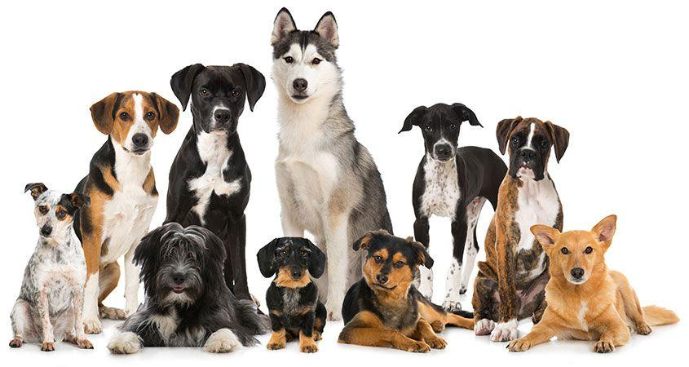
The dogs eat more and the drug appears safe given orally- hurrah! Now what?
What other things should we be measuring to evaluate safety?
If it works in laboratory dogs, how likely is it to work in pet dogs of different sizes and breeds?
What effect does it have on growth hormone and IGF-1 and how might that impact safety?
Once you stop administering it, does the appetite decrease? If so, how soon?

Slide 22
The dogs eat more, they like the new flavored liquid, the effect appears to remain stable, dogs gain some weight, and it appears safe.
Questions an animal scientist could help answer:
How should we design the first pilot study in client owned dogs with reduced appetite? How shall we measure appetite?
What patients should we include? Exclude?
How do we find veterinary clinics that might want to help us test the drug?

Slide 23
The dogs eat more, they like the new flavored liquid, the effect appears to remain stable, dogs gain some weight, and it appears safe.
Write a detailed protocol that specifies the hypothesis, everything that will be done during the study, how the data will be collected and analyzed, define the statistical methods to be used.
Draft a consent form for the owners, specifying the risks/benefits of the study.
Oversee the trial, making sure the vets and their owners and patients comply with the protocol.
How do we manage and analyze the data?

Slide 24
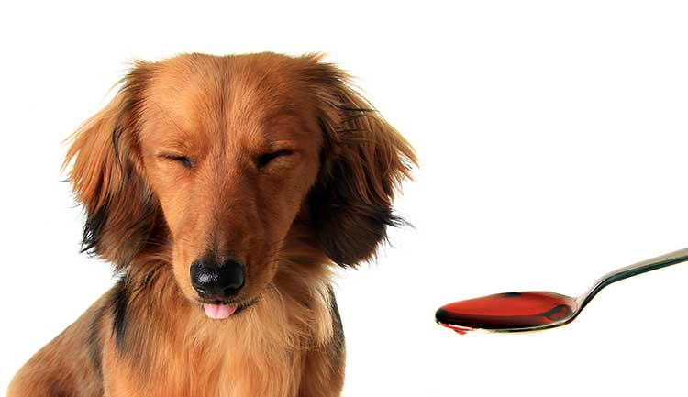
The client owned dogs with reduced appetite report increased appetite on the owner appetite scoring system, and the dogs gain weight. Some dogs vomit, some have diarrhea. Some of the control dogs get better too, but the statistics show a significant drug effect.
Questions an animal scientist could help answer:
Duplicate the pilot study, but with more dogs and more clinics
Figure out a good way to document the adverse effects
Talk to owners about how their dogs liked the formulation – was it easy to give?

Slide 25
Because of the success in a pilot trial in pets, time to conduct a pivotal study
An animal scientist could:
Negotiate a protocol for the pivotal study with the FDA
Help run the pivotal study (similar to the pilot study activities)
Write the final study report
Perform the statistical analysis
Help assemble and submit documents to FDA

Slide 26
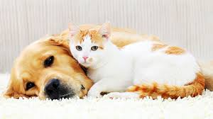
Because of the success in a pilot trial in pets, time to conduct a pivotal study
An animal scientist could:
Explore other indications – could it work to reverse cardiac cachexia? Could it work to stimulate appetite in cats?
Does the slight elevation in GH cause increased lean muscle mass in older dogs?

Slide 27
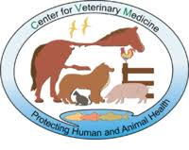
And so much more:
Quality assurance
Formulation development and testing
Center for Veterinary Medicine at the FDA
Vaccines, diagnostics development for animals
Technical services

Slide 28
Questions?
Notes:
Another word about risk.
When I started AlcheraBio, I left a good job at Merial, with a 401K, health benefits, sick and vacation days, and a regular paycheck.
Many of my colleagues were appalled at the risk I was taking.
I saw much more risk staying put. Companies were downsizing (they call it ‘right-sizing’), and middle aged people like me were finding it very hard to find another good job. There were mergers and acquisitions in the industry, where people were asked to relocate, or let go. Working in a big company had an illusion of safety.
It wasn’t too expensive to buy my own health insurance (for me and my son). I had some savings. I knew that if I could build up my business, I would, in the long run, be much safer.
Further, risk/reward. Being my own boss, deciding my own schedule, not having to ask permission for everything I did, deciding who I wanted to work with – made me happier in my professional life than I had ever been. I could spend more time with my son, without feeling I was jeopardizing my upward mobility in a company. And I worked like the devil, but when and where I wanted to work.
Frankly, I had fun in the last 10 years of my professional life, and I never could have predicted that this tale of two companies would turn out as it has. I encourage you to try it.

